Slide 1

AI- Based Voice Controled Virtual Assistant
Guided by : Dr.Samson Ebenezar
Presented By: SANDHEESH(1925260003)

Slide 2



INTRODUCTION
AI Voice-Controlled Virtual Assistant
A privacy-first, locally-running Alexa-like assistant powered by Qwen AI and LM Studio — all computation stays on your machine.

Slide 3
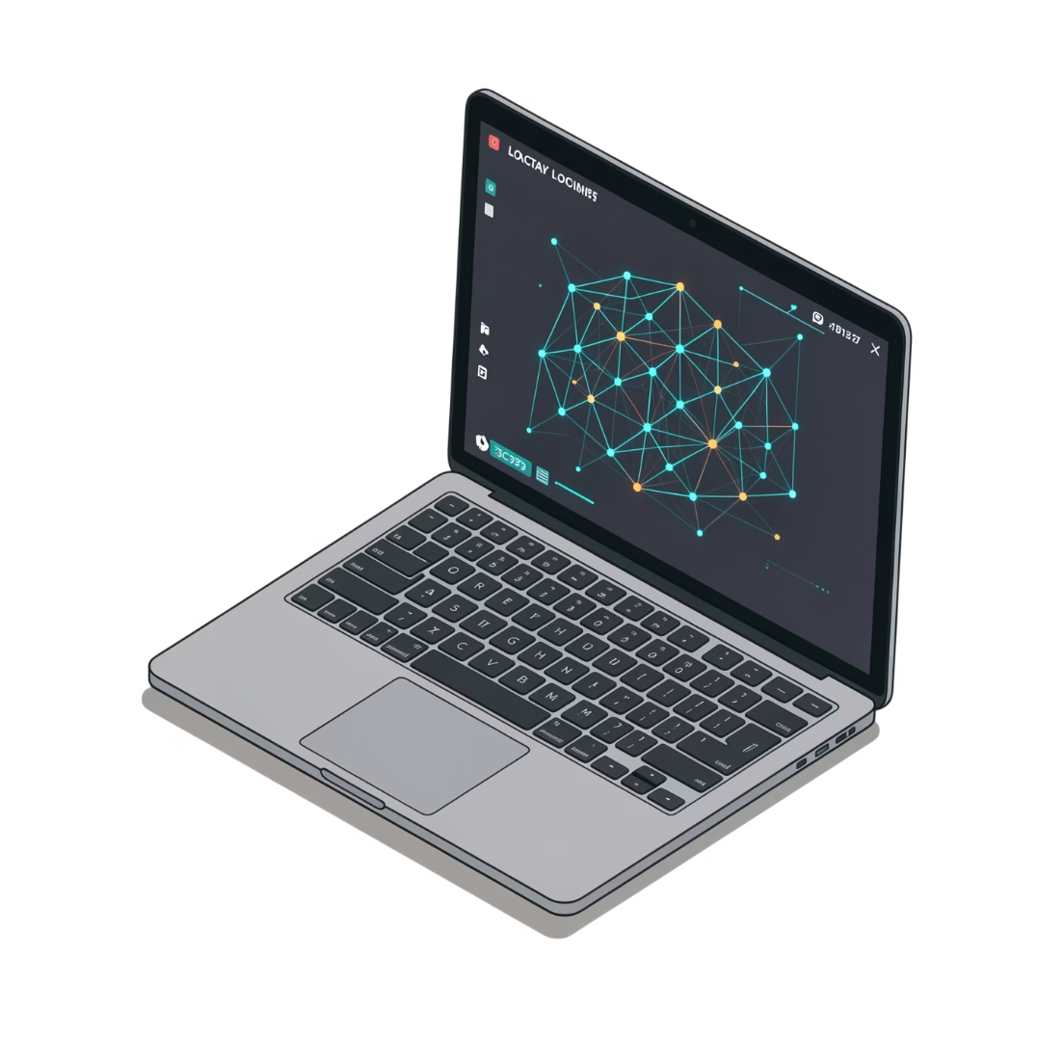

The Solution: Local-First Architecture
All processing on-device — no cloud calls, ever
Qwen AI model runs entirely via LM Studio on your hardware
Full voice privacy — your audio never leaves the machine
Fully customizable — modify prompts, behaviors, and pipelines freely
This is not a wrapper around a cloud API — it is a genuinely air-gapped intelligence stack.

Slide 4

Methodology:
Capture & Transcribe
Synthesize Output
Orchestrate & Infer
Each component in the pipeline is fully offline. The Python orchestrator acts as the central nervous system, coordinating audio capture, transcription, inference, and playback without any external network calls.

Slide 5
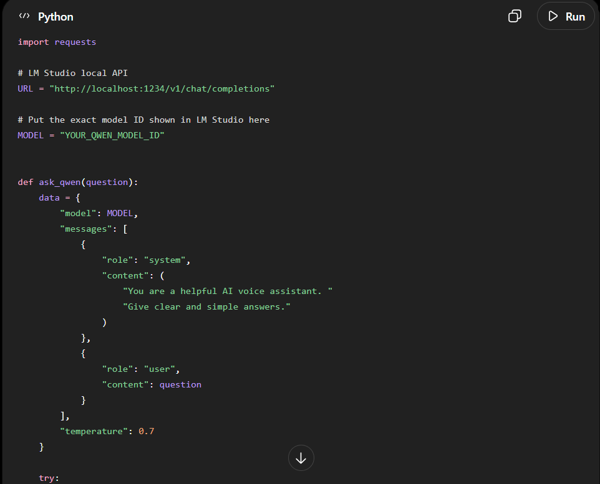

Slide 6
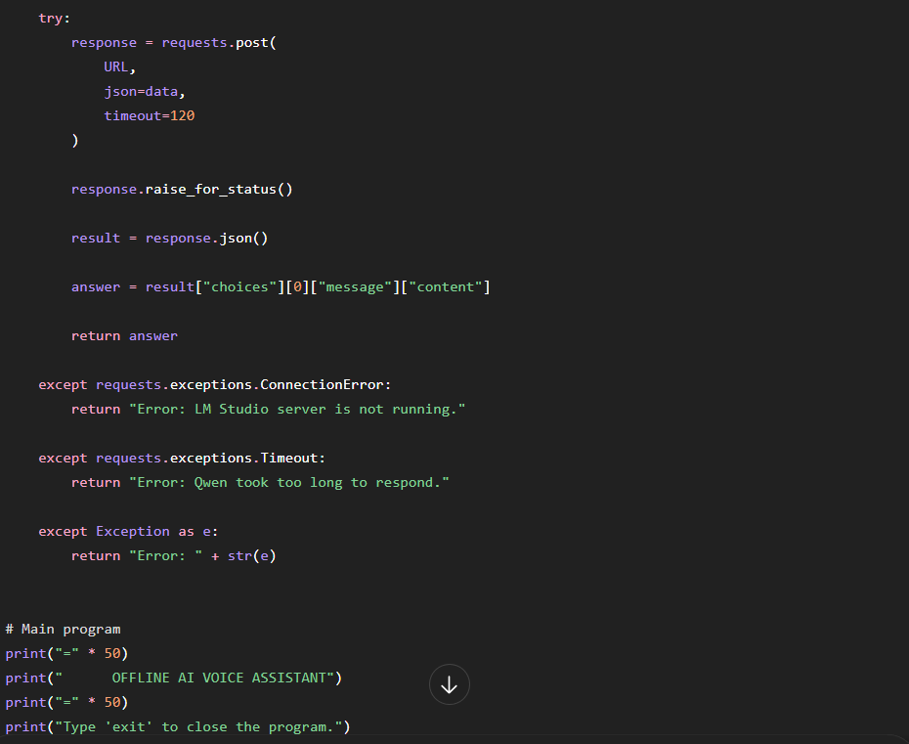

Slide 7


Slide 8
System Design:
Speak
Transcribe
Route
User speaks a command or question into the microphone.
Faster-Whisper processes the audio
buffer and outputs a text transcript — fully offline.
Python sends the transcribed text to the LM Studio local REST API endpoint.
Infer
Speak Back
Qwen processes the prompt and generates a contextually aware response.
Text-to-speech (Piper or pyttsx3) synthesizes
audio and the speaker plays the response.

Slide 9
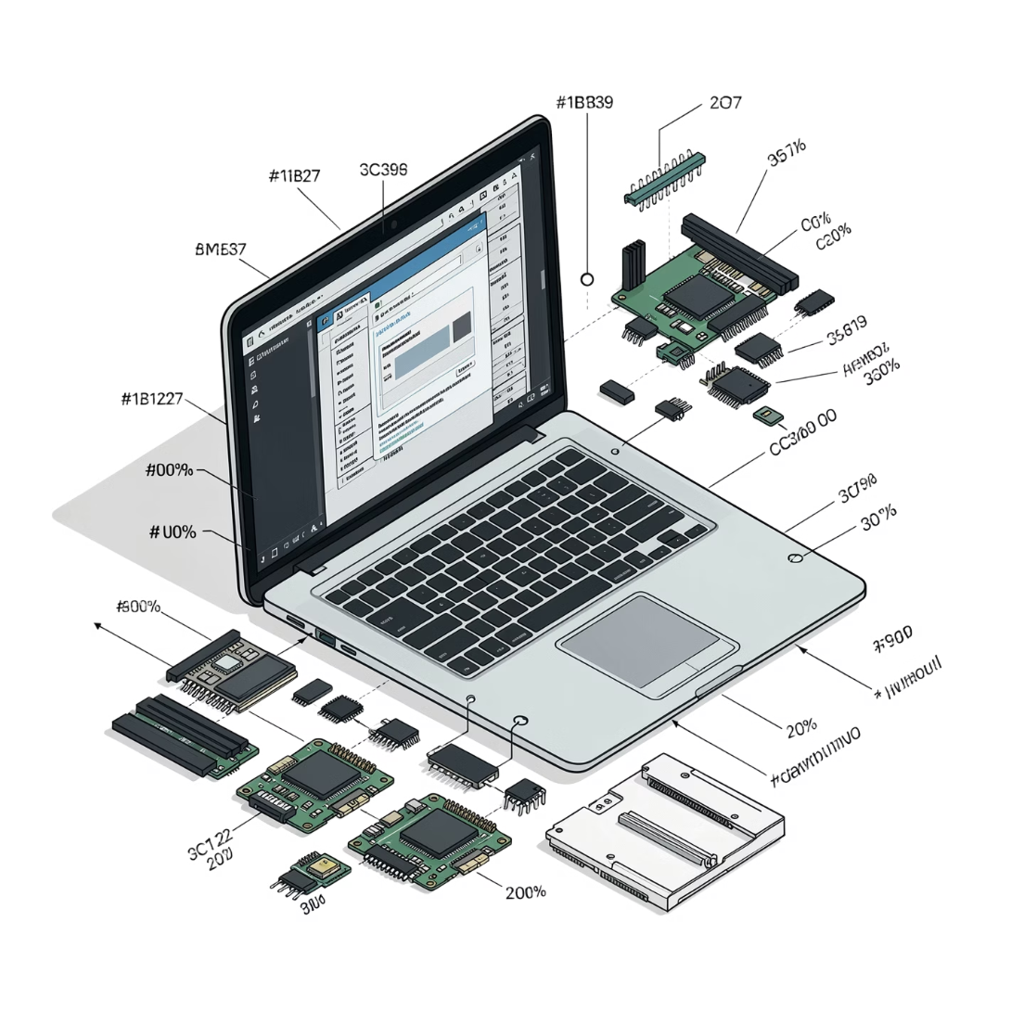
Hardware Requirements
Microphone & Speaker
RAM
GPU (Optional)
Minimum 8 GB to run the stack. 16 GB recommended for smooth Qwen inference.
CUDA-compatible GPU significantly reduces response latency. CPU-only is fully supported.
Any standard laptop mic and audio output — no specialized hardware needed.

Slide 10

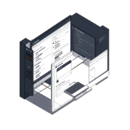
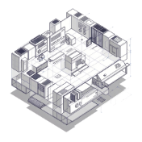

Software Stacks
Python 3.x
LM Studio
Qwen Model
Faster-Whisper
Main orchestration language — coordinates all components via clean, modular scripts.
Hosts the Qwen model locally and exposes an OpenAI-compatible REST API for inference.
Handles natural language understanding and response generation entirely on-device.
High-performance offline speech-to-text — CTranslate2-optimized Whisper inference.

Slide 11
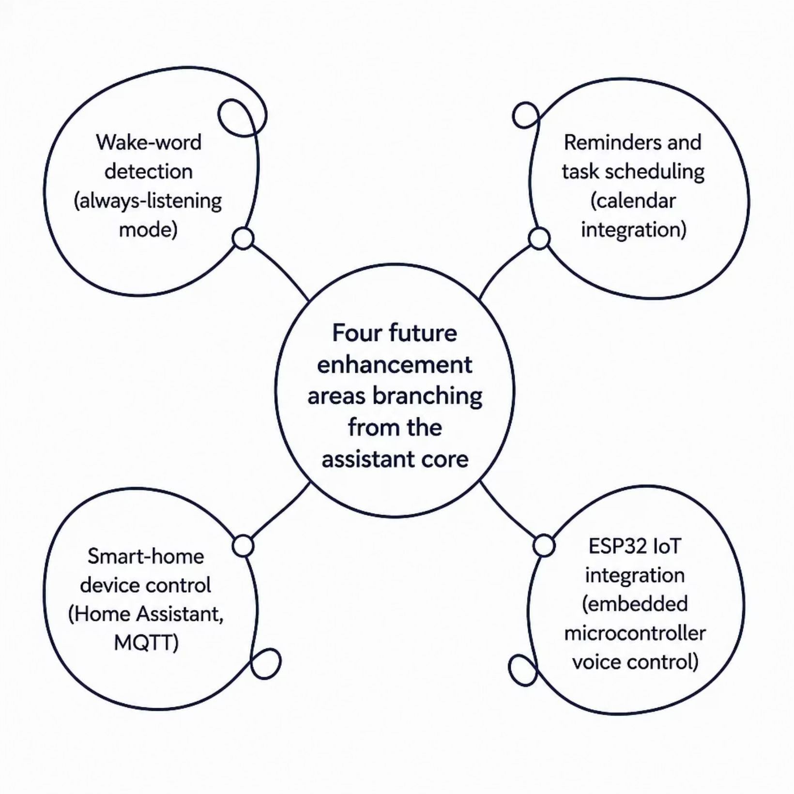
Future Enhancements
Wake-word detection — always-listening mode triggered by a custom hotword, no button press needed
Reminders & scheduling — natural language task creation integrated with local calendar systems
Smart-home control — send commands to local home automation hubs (Home Assistant, MQTT)
ESP32 IoT integration — extend voice control to embedded microcontroller devices over serial or Wi-Fi

Slide 12
The Advantage of Voice controlled Virtual assistant
Privacy
Customization
Zero cloud dependency. Voice data never leaves the device — no logs, no telemetry, no exposure.
Modify Qwen system prompts, swap models, and extend behaviors to fit any use case.
Offline-First
Zero Cost
Fully functional without an internet connection. Reliable in restricted or air-gapped environments.
No API fees, no subscriptions, no rate limits. Run inference as often as needed at no marginal cost.

Slide 13


